Slide 1

Shri Sant Gajanan Maharaj College of Engineering ,Shegaon
Project Title : Life Quest

Slide 2

LIFE QUEST
Group Member: Guided By:
Swapnil R. Murkute Prof. Ms.K.P.Sable
Kismat Shere
Rahul Bhaonani
Rajat Sadiwala
Vishal Zade

Slide 3

CONTENTS
PROBLEM STATEMENT
OBJECTIVE
LITERATURE SURVEY
PROPOSED SYSTEM
CLASS DIAGRAM
USE CASE DIAGRAM
STATE DIAGRAM
SEQUENCE DIAGRAM
ACTIVITY DIAGRAM
TECHNOLOGY USED
DESCRIPTION
CONCLUSION

Slide 4

PROBLEM STATEMENT
Emergency situations, such as accidents, create an immediate and critical need for specific blood types. In such emergency cases, it is difficult for hospital staff to collect blood in case of shortage of blood without having appropriate resources

Slide 5

OBJECTIVE
This project is aimed at developing an online platform that connects various hospitals , blood banks , receiver and donor.
This web application aim to serve as a communication tool between patients (who need blood) and blood donors .
The major goal of this project is to reduce the complexity of the system to find blood donors in an emergency situation .

Slide 6
Literature Survey
Sr. NO. | Title | Journal Name and Publish Year | Author | Conclusion
1 | Online Blood Bank Management System | Journal of Scientific Research in Computer Science and Engineering,2017 | Sindhu J Roopa M | It shows the comparision of various existing system and introduces some new ideas for improving existing techniques.
2 | Online Blood Bank Management | International Journal of Innovative in Science and EngineeringTechnology,2016 | Ashita Jain , Amit Nirmal, Nitish, | It helps to find the differences and evaluate the erros and have to improve it
3 | The Optimization of Blood Donor Information | International Conference on Engineering Technology and Science,2014 | P.Priya, V.Saranya, S.Shabana | Built an efficient and reliable blood donor information and manegment system based on web application

Slide 7
Proposed System
This system is providing the facility of viewing all information about donor details.
This system can provide information about the donor base on blood group and place where the donor is available for blood donation.
Searching of particular blood donor information is easy.
This system brings the communication link between various hospitals , blood banks and donors.

Slide 8
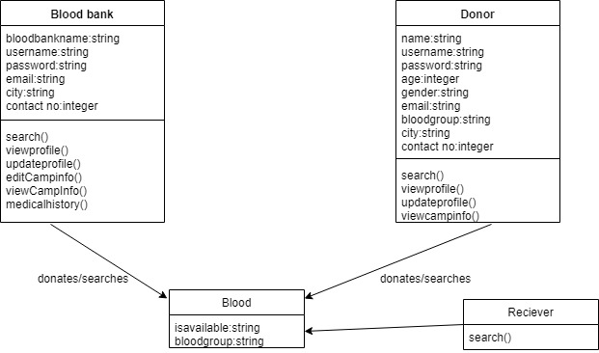
Class Diagram

Slide 9
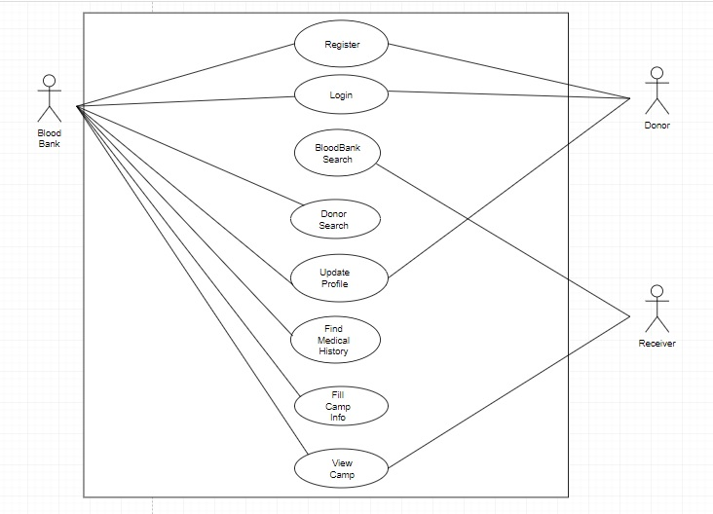
Use Case

Slide 10
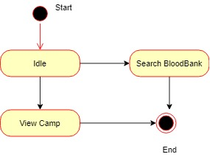
State Diagram for Receiver

Slide 11
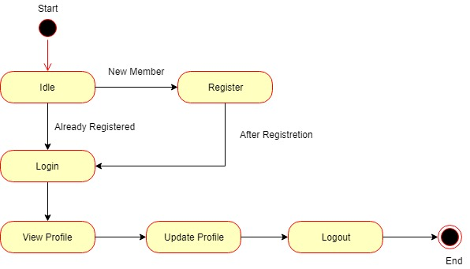
State Diagram for Donor

Slide 12
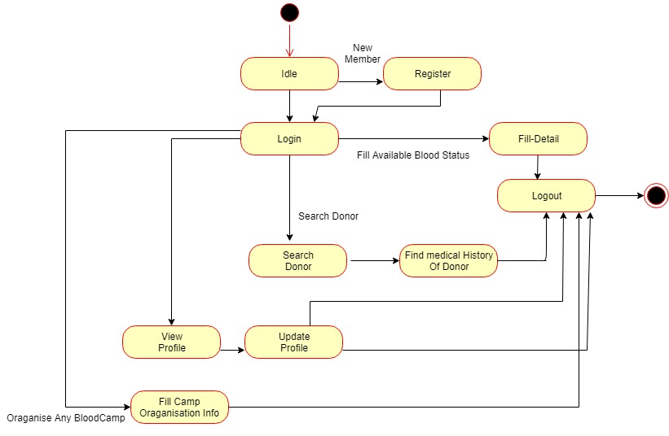
State Diagram for Blood Bank

Slide 13
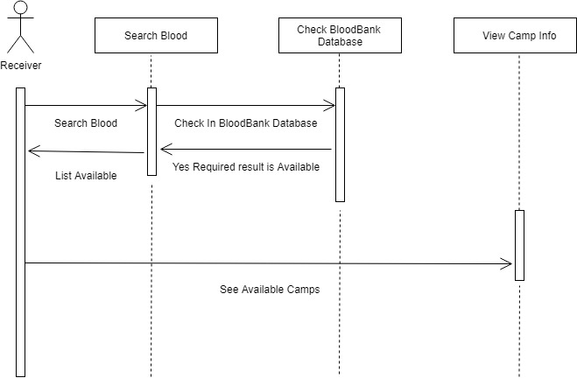
Sequence Diagram for Receiver

Slide 14
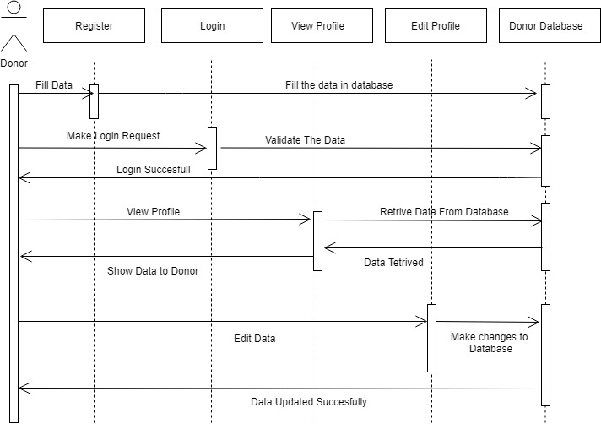
Sequence Diagram for Donor

Slide 15
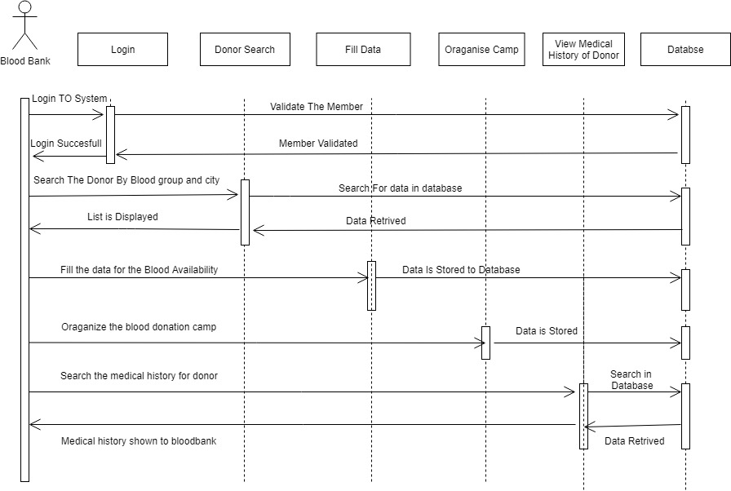
Sequence Diagram for Blood Bank

Slide 16
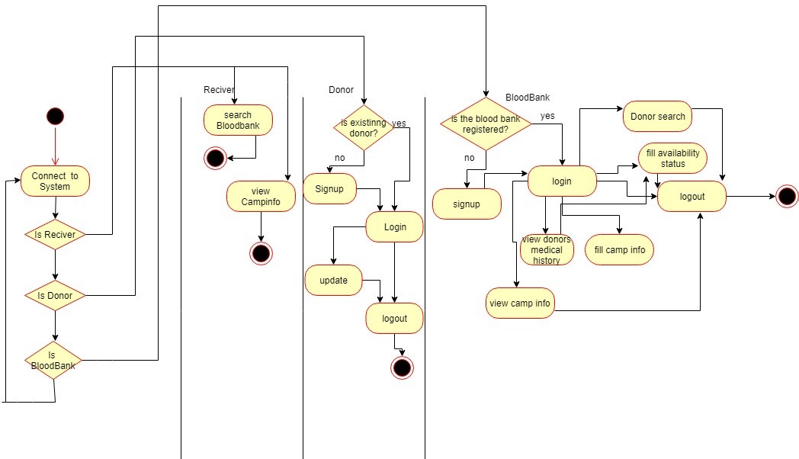
Activity Diagram

Slide 17
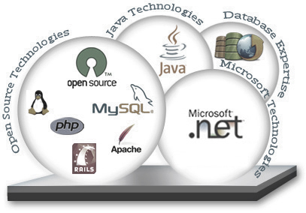
Technology Used
HTML
CSS
Servlet
Oracle-12c
SQL++
Apache-Tomcat

Slide 18

DESCRIPTION
Online blood management system is to provide service to people who are in need for blood by getting help from donors who are interested in donating blood to people
There are several modules in the system as follows :
Donor
Receiver
Blood bank

Slide 19

Conclusion
We can conclude by saying that blood donor database is an online centralized web portal which help blood banks , hospital and receiver to look donors in their near by area who will be available in quick time.

Slide 20
References
[1] Online Blood Bank Management System,Sindhu J.,Roopa M.,International
Journal of Scientific Research in Computer Science and Engineering,
Volume 2,Issue 2017
[2] Online Blood Bank Management,Ashita Jain,Amit Nirmal,Nitish,International
Journal of Innovative in Science and EngineeringTechnology,volume 2,
Issue 2,2016
[3] Blood Donor Communication,Natesh Pandi,Samaya Karuppan,Ramya P,
International Journal of Advance Research,volume 3,issue 2 ,2015
[4] Improve Blood Donation Process,Netrika W,Swati Deshmukh,International
Journal of Innovative Research in Computer Engineering,volume 3,Issue 5,
2015
[5] The Optimization of Blood Donor Information,P.Priya,V.Saranya,S.Shabana,
International Conference on Engineering Technology and Science,volume 3,
Issue 1,2014

Slide 21
Thank You

